Slide 1

SAP BTP – ABAP Extension SUIT

Slide 2

Curriculum
Introduction into SAP BTP ABAP Environment
Hands-on Session on ADT
SAP BTP Workflow
Evolution of ABAP Programming Model - classical to RAP/CAP
Explore CDS views using RAP
Side by side extension Between SAP BTP ABAP and SAP Backend
Explore ABAPGIT

Slide 3
Introduction into SAP BTP ABAP Environment

Slide 4
Contents
Introduction
Why ABAP in SAP BTP?
Values of SAP BTP ABAP Environment
Vital Parts of SAP BTP ABAP Environment
Installation & Connection Setup - ADT and BAS
BTP Setup and ABAP trial Access

Slide 5
Introduction
SAP Business Technology Platform is the technological foundation for all SAP applications and the Intelligent Enterprise. Customers can achieve agility, business value and continual innovation through integration, data to value and extensibility of all SAP and third-party applications & data assets.
SAP Cloud Platform has been rebranded as SAP Business Technology Platform (BTP). When compared to SAP SCP, the functionality offered by SAP BTP is much greater because it is an advanced stage of the SAP Cloud offering.
SAP BTP Core Quality: -
Unified Platform
Centralized Business
Creating an Open Architecture

Slide 6
Business application studio
SAP Business application studio is a solution provided on SAP BTP which provides an advanced development environment.
This whole studio is available as an SAP cloud service and provides a desktop-like experience.
Development spaces ("dev spaces") are the most important elements of SAP Business Application Studio. They act as storage for your artifacts (e.g., sepa-rate virtual machines running within the cloud) by containing custom tools and preinstalled runtimes for your business scenarios, such as SAP Cloud Application Programming Model, SAP Fiori, SAP S/4HANA, and so on.
A dev space is an environment integrated with all the tools, functionalities and resources required to develop your application.

Slide 7
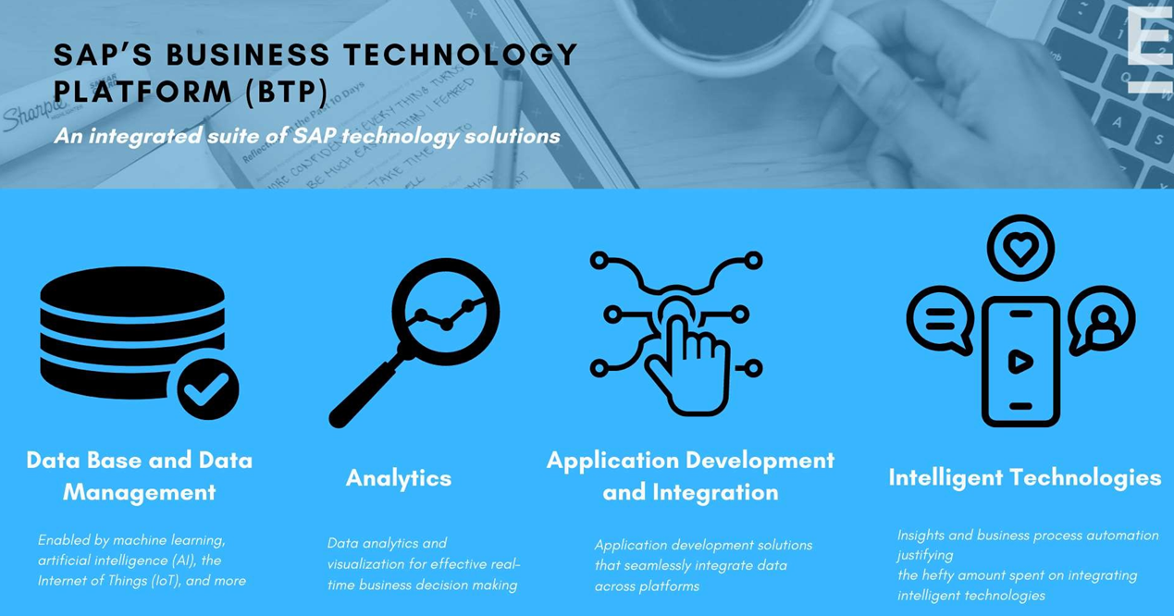

Slide 8
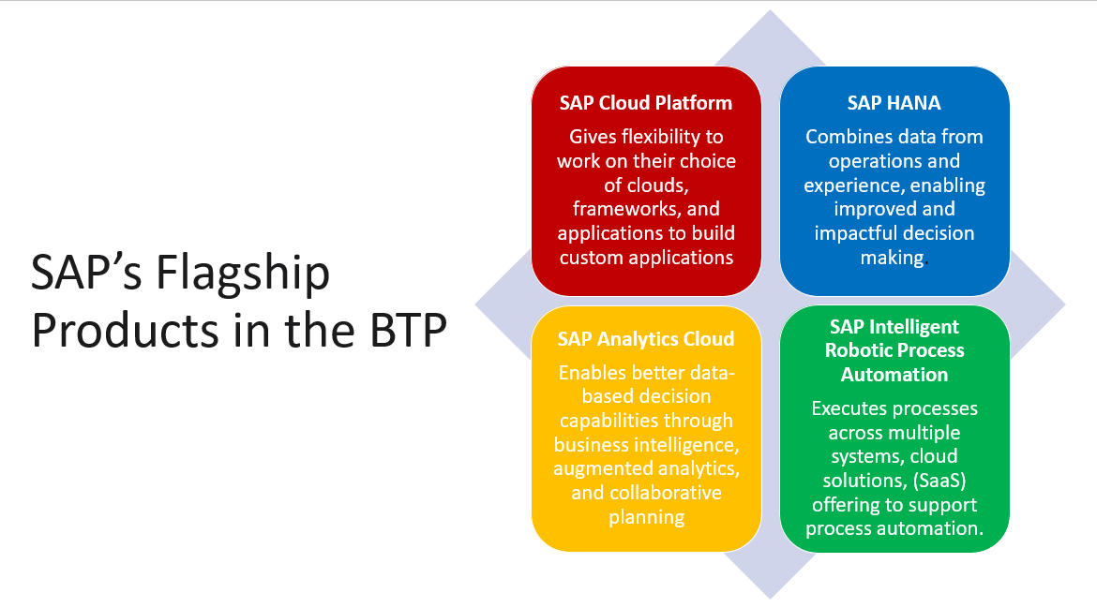

Slide 9
Why ABAP in SAP BTP ?
SAP BTP, ABAP environment is a platform-as-a-service (PaaS) that enables developers to build cloud applications using a cloud-optimized version of the ABAP programming language.
What is PaaS?
“ A model in which a third-party provider hosts application development platforms and tools on its own infrastructure and makes them available to customers over the internet. ”
In this presentation, we will explore the new SAP Business Technology Platform (BTP) ABAP Environment – formerly known as SAP Cloud Platform ABAP Environment.
Quick introduction to SAP BTP ABAP Environment and Hands-on sessions with HTTP Service in Eclipse
Create an end-to-end example to illustrate the various features present within the cloud-optimized version of the ABAP programming language.

Slide 10
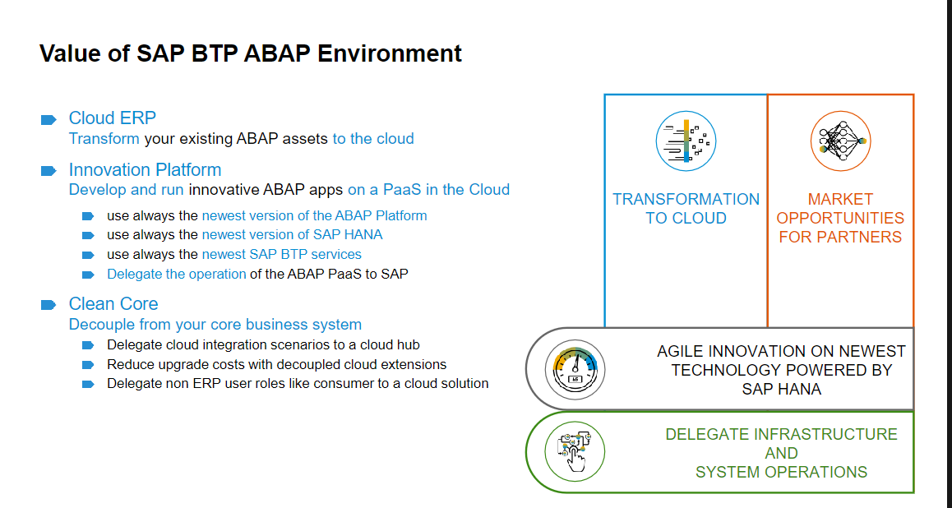

Slide 11
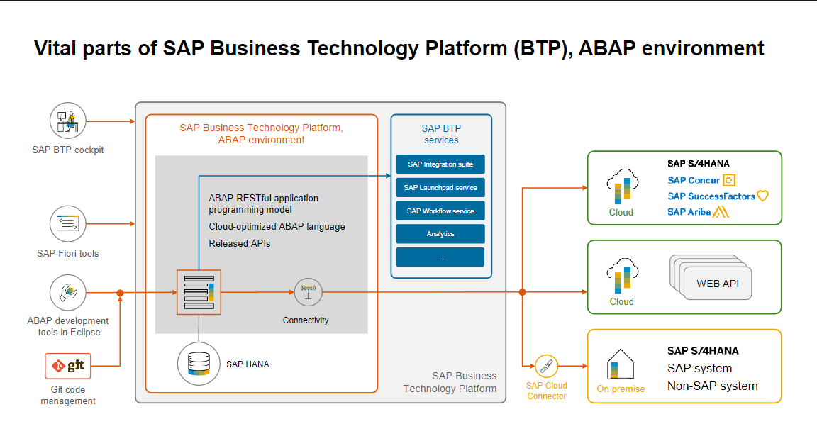

Slide 12
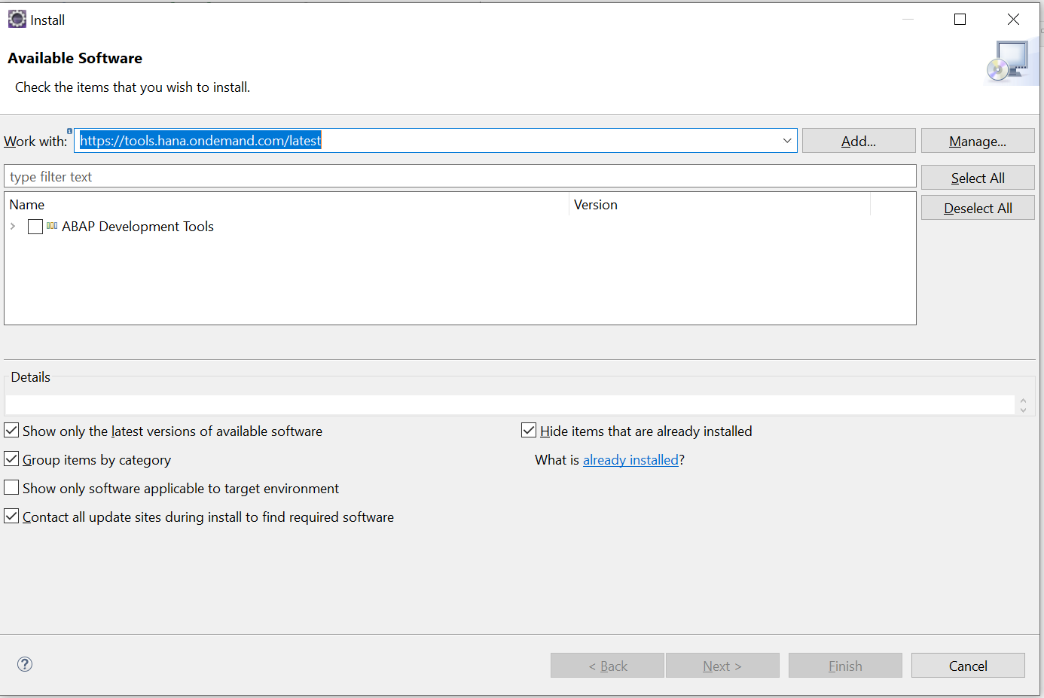
Installation & Connection Setup - ADT and BAS 1. Eclipse installation/ Add plugins
Install the latest version of the eclipse from here
To add the SAP Plugins.
Go to the help menu and click on Install new software option.
Go to https://tools.hana.ondemand.com/ and based on the compatible version of eclipse select the URL to install the SAP Plugins.
The selected URL is then used in the eclipse to install the required SAP Plugins.

Slide 13
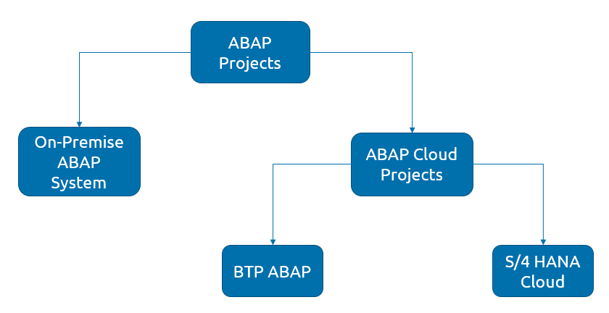

There are two kinds of ABAP Projects in ADT.
On-premise ABAP system
ABAP Cloud Projects
ABAP Cloud Projects we used to connect either to SAP BTP ABAP or SAP S/4 HANA Cloud.

Slide 14
BTP Setup and ABAP Trial Access
The attached document has steps to setup ABAP on Cloud Project.

Slide 15
2. Installation & Connection Setup - BAS

Slide 16
Hands-on Session on ADT

Slide 17

WORKING ON ADT

Slide 18
SAP BTP – Application Development Environments

Slide 19
SAP BTP – Application Development Environments
Environments provides the runtimes, tools, technologies that you need to build the applications.
ENVIRONMENTS
KYMA
NEO
CLOUD FOUNDRY
ABAP
ABAP RAP MODEL

Slide 20
ABAP ENVIRONMENT
Allows you to create extensions for ABAP-based products, such as S/4 HANA Cloud & make new applications
ABAP environment is a new space we can create within Cloud Foundry environment for ABAP development.
Let's you transform existing ABAP-based custom code or make extensions to the cloud.
ABAP environment supports the ABAP RESTful Application Programming Model including SAP Fiori and Core Data Services (CDS).
ABAP environment can be integrated with other SAP BTP services, such as SAP Destination service, SAP Launchpad service, SAP Workflow Management, and SAP Interactive Forms by Adobe.

Slide 21
ABAP RESTful Application Programming Model (RAP)
The ABAP RESTful Application Programming Model defines the architecture for efficient end-to-end development of intrinsically SAP HANA-optimized OData services (such as SAP Fiori apps) in the ABAP environment.
It supports the development of all types of Fiori applications as well as publishing Web APIs.
It is based on technologies and frameworks such as Core Data Services (CDS) for defining semantically rich data models and a service model infrastructure for creating OData services with bindings to an OData protocol and ABAP-based application services for custom logic and SAPUI5-based user interfaces

Slide 22
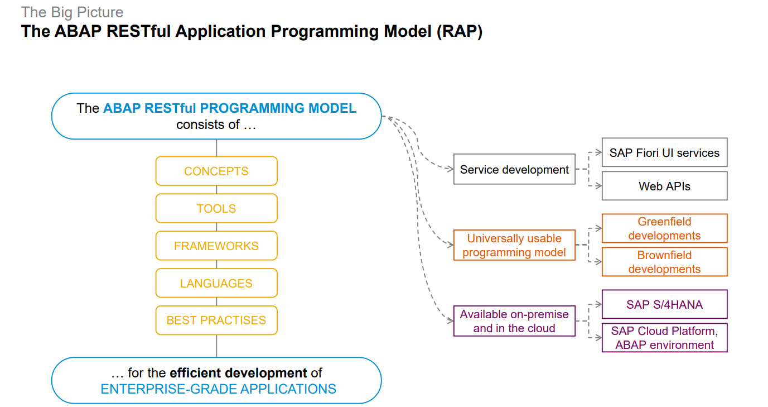
ABAP RESTful Application Programming Model
The ABAP RESTful Application Programming Model is available in the following products:
SAP BTP ABAP environment
SAP S/4HANA Cloud

Slide 23
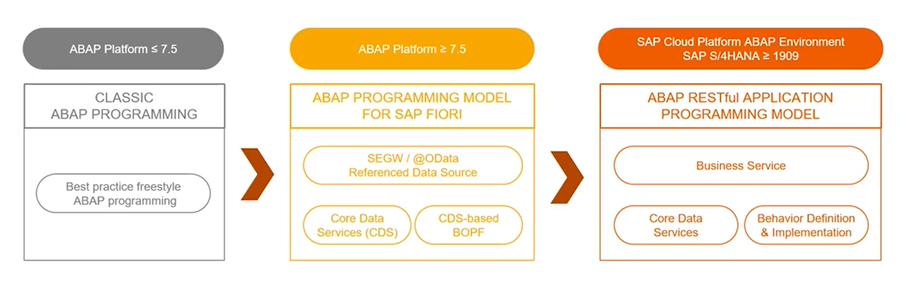
EVOLUTION OF THE ABAP PROGRAMMING MODEL

Slide 24
RAP – KEY PLAYERS

Slide 25

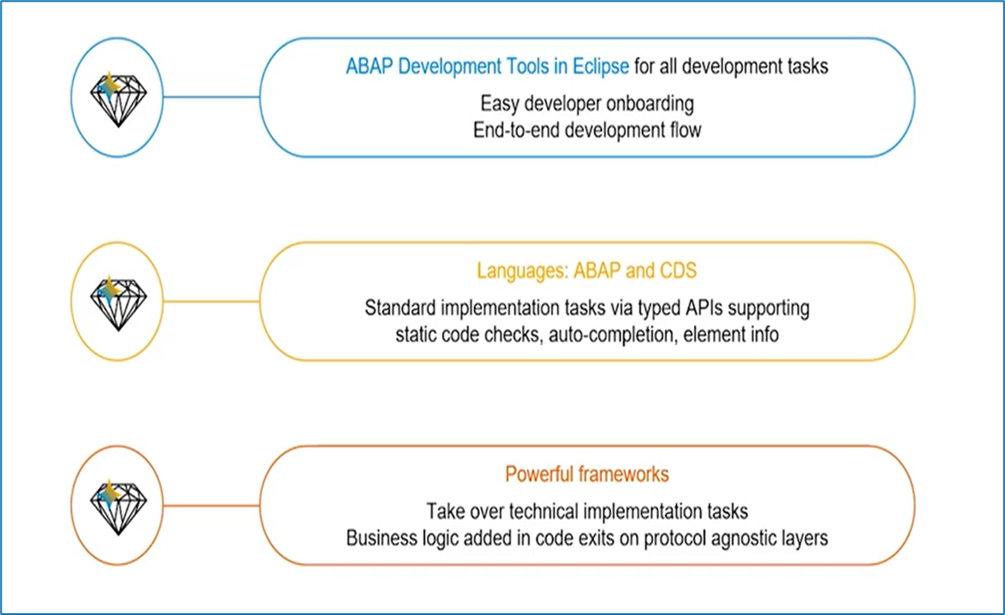
RAP – KEY PLAYERS

Slide 26
Uses of rap model:
Eclipse-based experience for the backend development tasks in the ABAP Development Tools:
Eclipse-based editors provided for all involved standard tasks; SAP GUI no longer needed
Clear entry point and clear development flow from one task to the next one
Fast developer on-boarding without reading tons of documentation
ABAP Language and CDS are the main interfaces to the developers :
Direct support for business object development (data modelling and transactional enablement) in CDS and the ABAP Language
No need for separate framework such as BOPF and framework-specific tools; No code generation and therefore avoidance of possible code redundancies and inconsistencies
Standard implementation tasks via typed APIs supporting useful IDE features like static code checks, auto-completion and element info
Avoidance of runtime errors by using static code checks thanks to typed APIs

Slide 27
Uses of rap model:
3. Powerful frameworks for runtime components
Taking over and standardizing the technical implementation tasks
With dedicated code exits for application-specific business logic
4. While SAP ABAP programming model for SAP Fiori is a key advantage in terms of evolving landscape, flexibility and efficient modelling for SAP Fiori, SAP HANA; it lacks certain criteria like simplicity and typed access to business entities which seems to be the basic need for application development and RAP fills the gap
5. Brownfield scenarios are not supported by the ABAP Programming Model for SAP Fiori, but it is supported by the ABAP RAP Model

Slide 28
RAP ARCHITECTURE

Slide 29
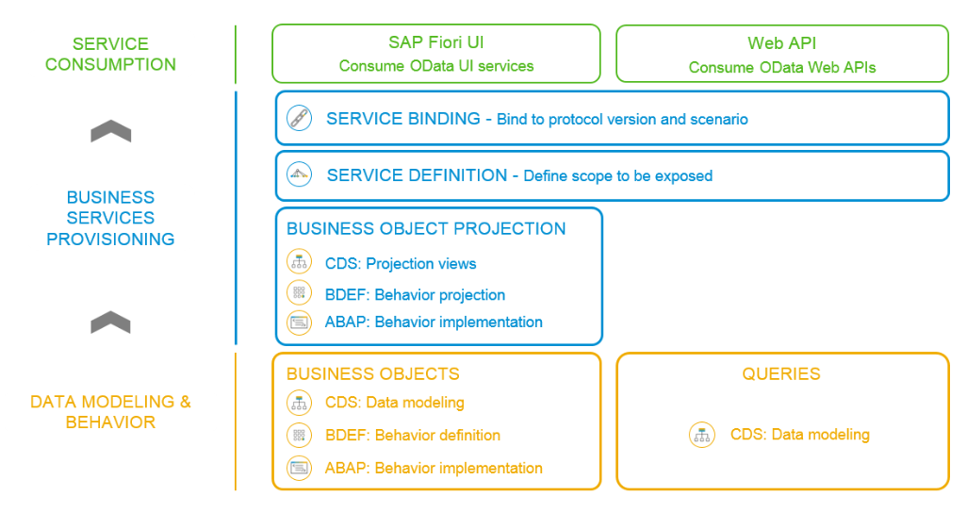
RAP ARCHITECTURE

Slide 30


The SAP ABAP RAP model has a three-layered architecture:
The base layer of RAP is DATA Modelling and Behavior. Here, we define the business object models, query definitions and their transactional behavior. Taking an example of a simple SAP Fiori based application, we define the database table and expose the data using CDS. As soon as the CDS for the root entity is created, we define the transactional behavior also.
Data Modelling and Behavior
01
In the middle layer, business object projection and the OData exposer happens. The OData exposer is done in two steps: the first step is where the protocol service scope definition of relevant data entities is defined, and the second step is data binding to the OData model. For example, we have 50 CDS views relevant to Sales - Order but we want only 1 view to be exposed to the outside world. This scenario can be achieved via this layer.
02
Business Services Provisioning
03
Service Consumption
The topmost layer is the Service Consumption layer. Here, an OData Service can be exposed as a UI service which can be consumed by SAP Fiori or Web API, that can later be consumed by any client.

Slide 31
RAP v/s CAP

Slide 32
SAP RESTful Application Programming (RAP)
The SAP RESTful Application Programming Model defines the architecture for efficient end-to-end development of intrinsically SAP HANA-optimized OData services (such as SAP Fiori apps) in the ABAP environment.
It supports the development of all types of Fiori applications as well as publishing Web APIs.
It is based on technologies and frameworks such as Core Data Services (CDS) for defining semantically rich data models and a service model infrastructure for creating OData services with bindings to an OData protocol and ABAP-based application services for custom logic and SAPUI5-based user interfaces

Slide 33
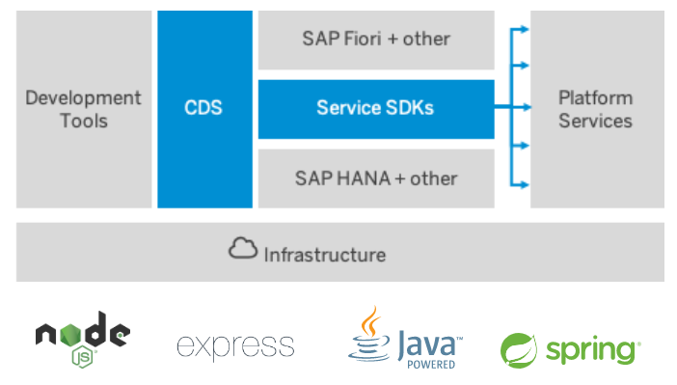
SAP Cloud Application Programming (CAP)
SAP Cloud Application Programming Model (CAP) is a framework of languages, libraries, and tools for building enterprise-grade services and applications. It guides developers along a golden path of proven best practices and a great wealth of out-of-the-box solutions to recurring tasks.
It is the recommended programming model for the ‘Cloud Foundry’ environment by SAP
The CAP framework features a mix of proven and broadly adopted open-source and SAP technologies, as highlighted in the figure below:

Slide 34
RAP v/s CAP
Comparison | SAP CAP | SAP RAP
Type of Service | Only Cloud Service. | Both on Premise and Cloud Services.
Technology | Open Source + SAP Stack (HANA DB, CAP CDS, SAP UI5). | SAP CDS and SAP ABAP (or ABAP on Cloud).
Data Base | The data base can be only HANA Database (on cloud). | The data base can be either SAP conventional S4HANA or HANA Database (on cloud).
Application Layer | Application layer can be Node.js or Java. | Application layer is ABAP.
Frontend | UI development is supported. | Only APIs are generated, UI development is not part of RAP architecture.
Deployment | It can be deployed only on Cloud Foundry as a single package (MTA.yaml that consists Database + Micro services + UI) or two package (UI is separated in this case). | The RAP is hosted via ABAP on cloud, which can be also only deployed over cloud foundry. But the UI application consuming the services generated by SAP RAP can be deployed over either Neo or Cloud Foundry.
ABAP Reports Support | The services generated by CAP can be used by ABAP reports via external HTTP request calls. | The services generated by SAP RAP can be used directly in ABAP Reports via Entity Manipulation Language (EML).
OData Support | SAP CAP only supports OData V4. But it can utilize plugins to downgrade the services to OData V2. | You can create both OData V2 and V4 services.
Development IDE | SAP CAP can be developed using SAP Business Application Studio (BAS) or Visual Studio. | SAP RAP can be developed using HANA Studio/Eclipse in case of on-premise as well as ABAP on cloud.

Slide 35

Expose cds view using RAP in sap s/4 hana

Slide 36
Concept of CDS View using RAP
1

Slide 37
Concept of CDS View using RAP
ABAP RESTful Application Programming Model in CDS View: Some clients have huge ABAP Repositories, and it is understandable if they would want to continue using it in S/4 HANA environment as well. SAP BTP ABAP environment is what they would then use for the cloud ready developments. RESTful OData Services based on CDS (Core Data Services) views too can be created.
We can expose a CDS View without even explicitly creating an OData service through this RAP.

Slide 38
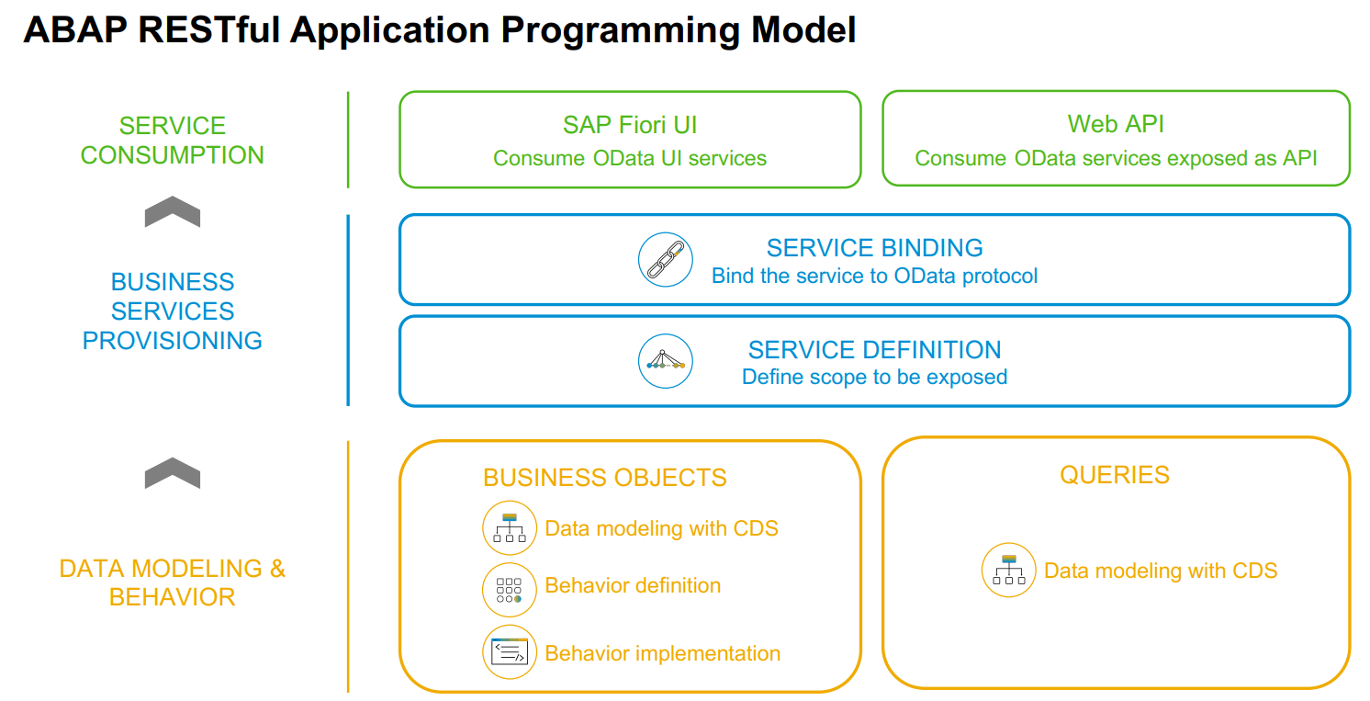
Concept of CDS View using RAP

Slide 39
Concept of CDS View using RAP
The ABAP RESTful Programming Model (RAP) was made available in BTP in 2018. RESTful refers to representational state transfer which defines how APIs are used. In this case, they are the services (e.g. OData) based on CDS views.
The ABAP RESTful Programming Model (RAP) allows database tables, CDSs and services to defined and built from code in flat text files. “Annotations” in “CDS Projected Data Model” are used to define user interface parameters like column positions and search parameters.

Slide 40
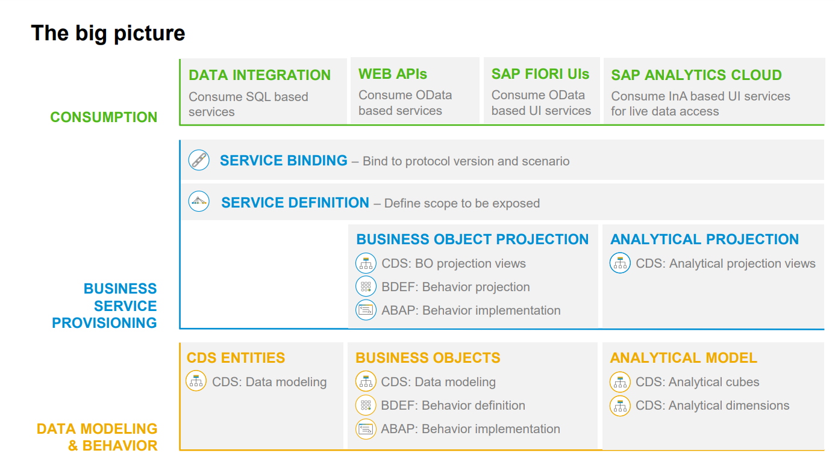
Concept of CDS View using RAP

Slide 41
Availability of CDS views in SAP platforms
2

Slide 42
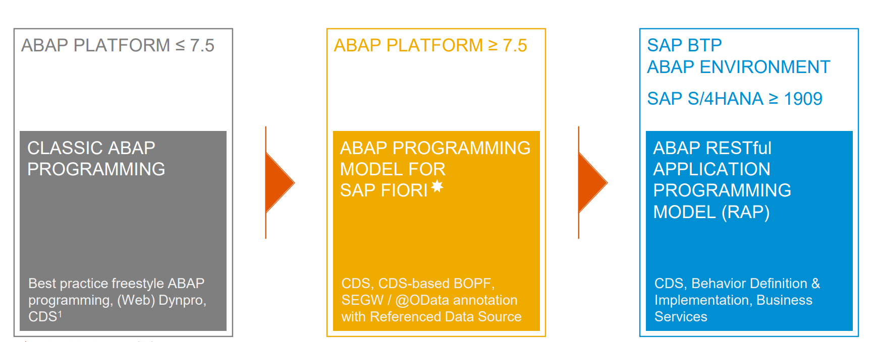
Availability of CDS views in SAP platforms

Slide 43
Development Flow of CDS View
3

Slide 44
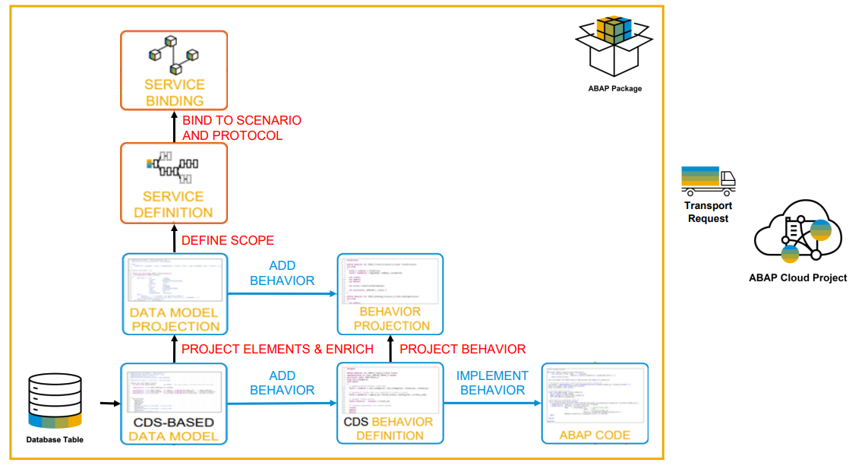
Development Flow of CDS View

Slide 45
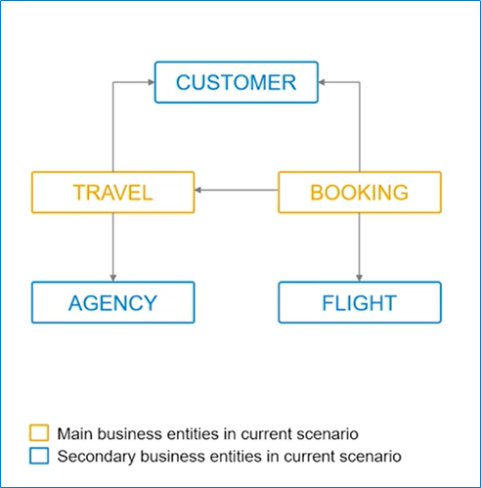
Development Flow of CDS View
Scenario: Travel App:
Entities: Customer, Travel, Booking, Agency and Flight.

Slide 46
Exposing CDS View using RAP
Part 1: Data Modelling and Business Service Provisioning and consumption
Travel based Managed Scenario:

Slide 47
Create an sap Fiori app and DEPLOY it to sap btp environment
Adding Behaviour, implementing the behavior, Creating an sap fiori application through Business Application Studio and deplpoy it to sap btp platform.

Slide 48
Benefits of CDS view using RAP in SAP S/4 HANA
4

Slide 49
Benefits of CDS view using RAP in SAP S/4 HANA
The major benefit of RAP is first it now follows global development paradigm for Web development i.e. REST services. This makes it uniform with all other programming languages and also makes integration with system much easy.
Another benefit is, it does not create bunch of objects like BOPF. The implantation is very LEAN.
It does not create new classes with every implementation, does not create lots of structures etc. also SEGW project is not created for RAP.
It also cuts the annotation assignments to CDS views (Hence we have to remember less annotation keywords).

Slide 50
Conclusion
5

Slide 51
Conclusion
CDS view is able to consume sources other than database tables/views, such as OData services.
Preview Option.
Advance level of adding UI Annotations.

Slide 52

References
https://blogs.sap.com/2022/04/30/steampunk-is-not-just-sci-fi-anymore/
https://open.sap.com/courses/cp13
https://developers.sap.com/tutorials/abap-environment-deploy-cf-production.html
https://developers.sap.com/group.abap-env-restful-managed.html

Slide 53
Side-by-Side Extensions Between SAP BTP ABAP and SAP Backend

Slide 54
Contents
Extensions
Introduction
Advantages
Use Cases
Extension Suite
In-App vs Side by side extensibility

Slide 55
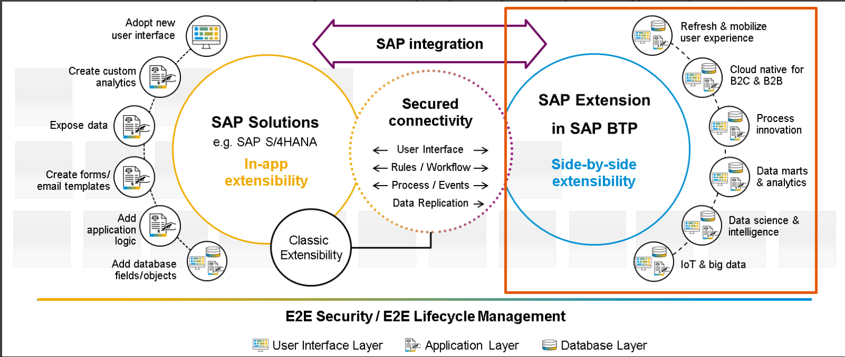
SAP S/4 HANA EXTENSIBILITY

Slide 56
Introduction
Side-by-side extensions are software application running externally to the core application (SAP S/4HANA Cloud) and interacting with it using SAP standard APIs.
Side-by-side extensions can be coded using potentially any programming language, nevertheless some languages are better supported by SAP, in particular ABAP, Java and JavaScript
Side-by-side extensions provide a freedom of expression and do not suffer the restrictions of in-app extensions.
They can potentially run on any run-time application platform, nevertheless SAP provides and recommends it's dedicated platform: the SAP Business Technology Platform.

Slide 57
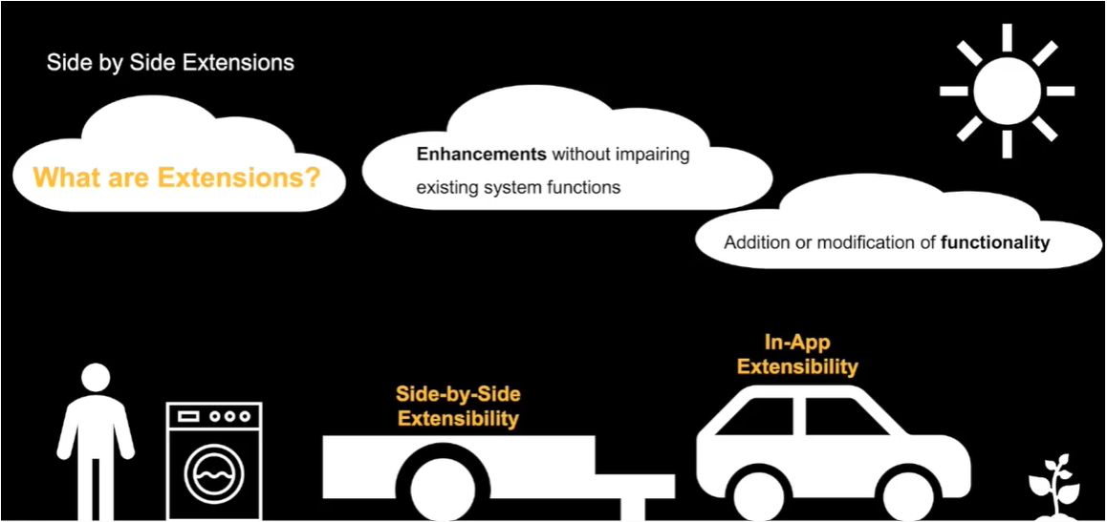

Slide 58
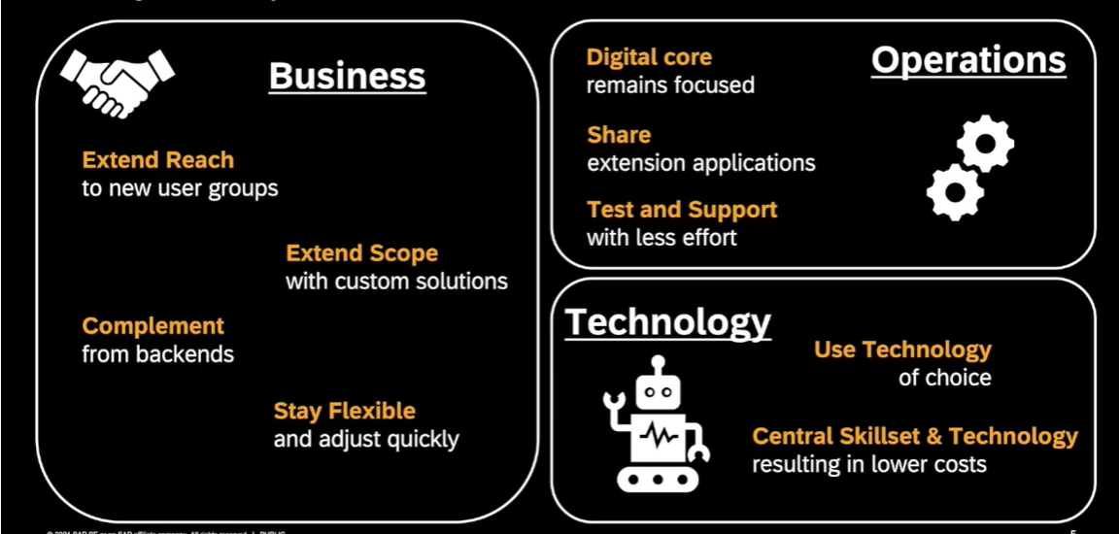
ADVANTAGES

Slide 59
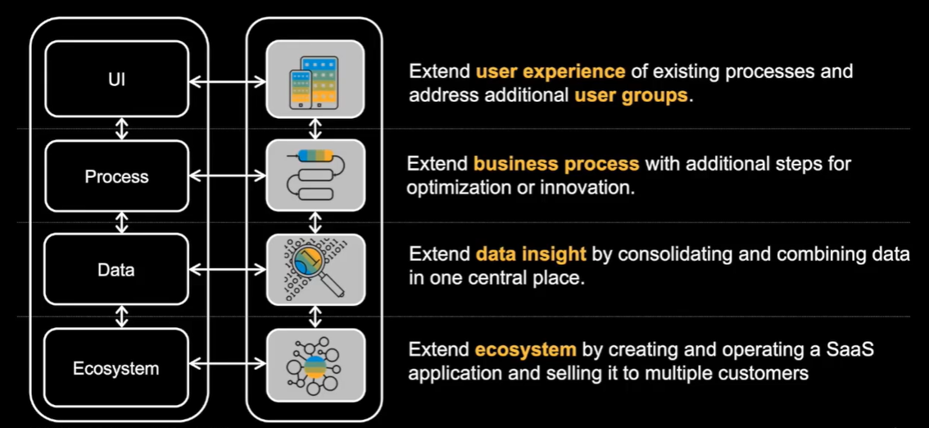
Use Cases for Side By Side Extensions

Slide 60
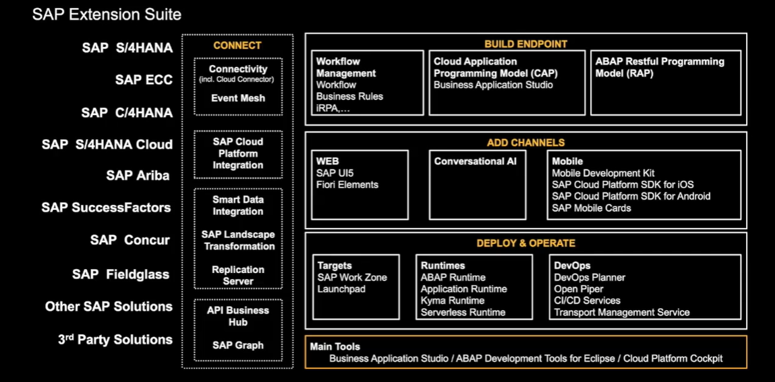
Extension Suite

Slide 61
SAP Extension Suite offers you the full set of capabilities to develop, test, and run your individual applications in a fast and economic way by using its broad set of reusable features to ensure consistency across your landscape, and leverage your existing investments and expertise.
It allows an easy and secure way to enhance the pre-built scope of SAP solutions with simple onboarding, powerful APIs and events, and optimized developer tools.
Four Steps to build extensions
Connect.
Build an endpoint.
Add channels.
Deploy and operate.
The SAP Extension Suite allows you to deliver consistent and collaborative experiences in SAP and new applications across all channels. Automate, enhance, and adapt business processes beyond standard solutions.

Slide 62
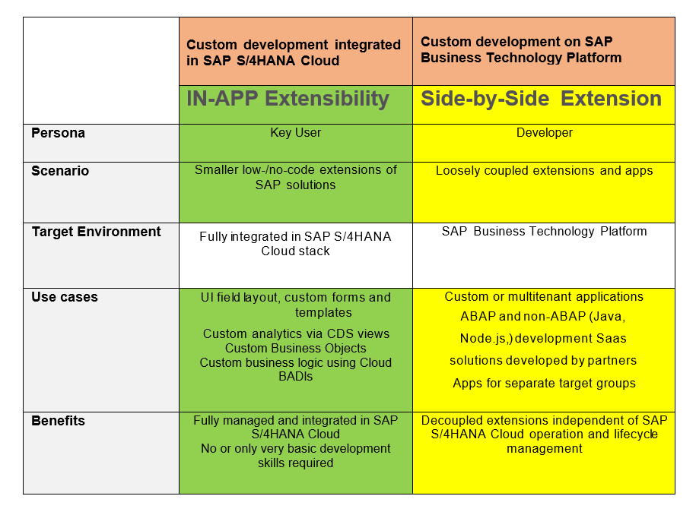
In-App VS Side by side Extensibility

Slide 63
References
https://microlearning.opensap.com/media/Side-by-Side+Extensions+on+SAP+BTP+-+SAP++Business+Technology+Platform/1_bkutekla
Case Study :
https://help.sap.com/docs/SAP_EXTENSIBILITY_EXPLORER/757c85f07ab84278927025e6fd6ea6d2/8e69bf12ce58403ca9541c47dd708a25.html

Slide 64
Transfer ABAP Source Code via abapGit

Slide 65
Introduction
SAP Business Technology Platform is the technological foundation for all SAP applications and the Intelligent Enterprise. Customers can achieve agility, business value and continual innovation through integration, data to value and extensibility of all SAP and third-party applications & data assets.
The ABAP source code editor is provided for developing or editing ABAP source code in Eclipse. The ABAP source code editor corresponds to the ABAP editors in SAP GUI, such as the Program Editor ( SE38 ), Function Builder ( SE37 ), and the source code-based Class Builder ( SE24 ).
ABAPGIT is an open source git client for ABAP, maintained and built by the community. ABAPGIT is about code Management, including versioning, branching, Merging etc, while building code in development environment.

Slide 66
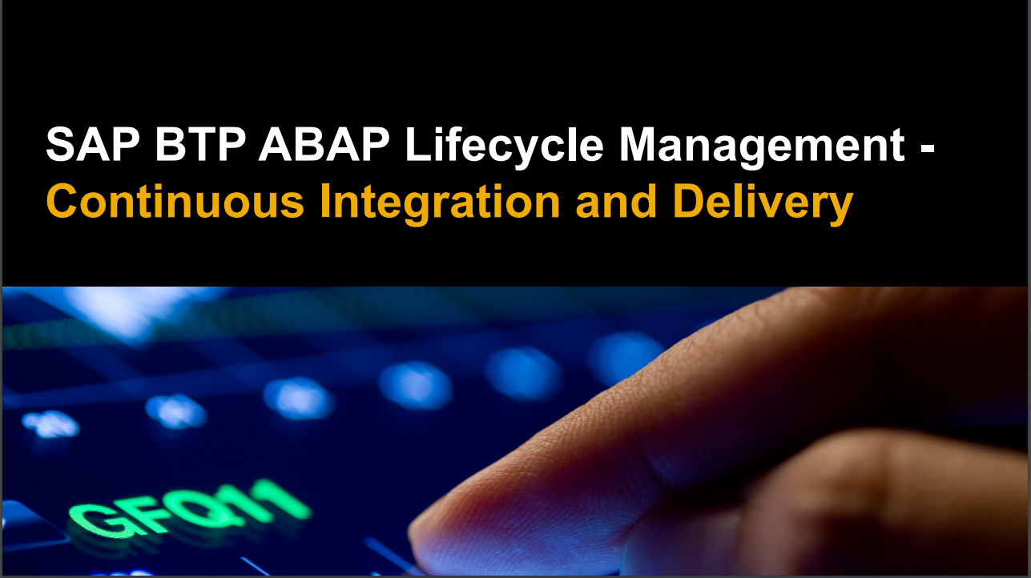

Slide 67
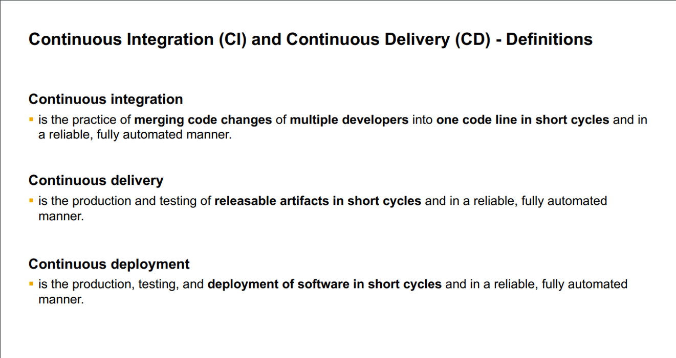

Slide 68
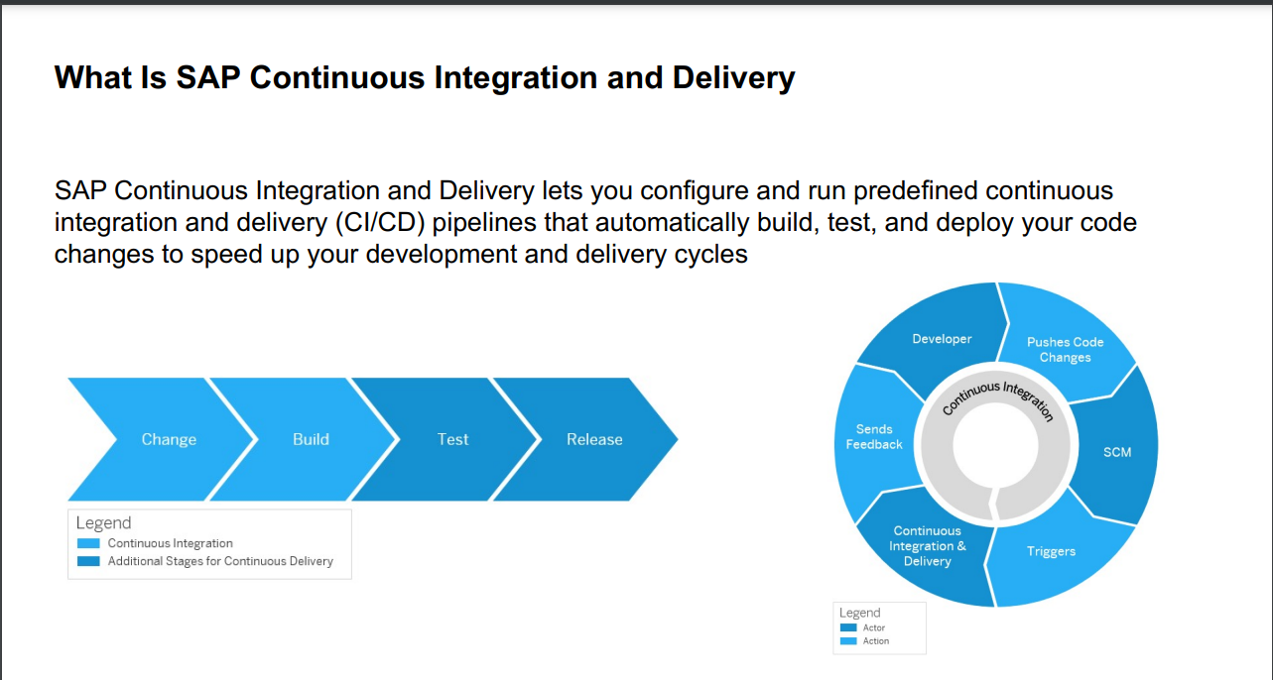

Slide 69
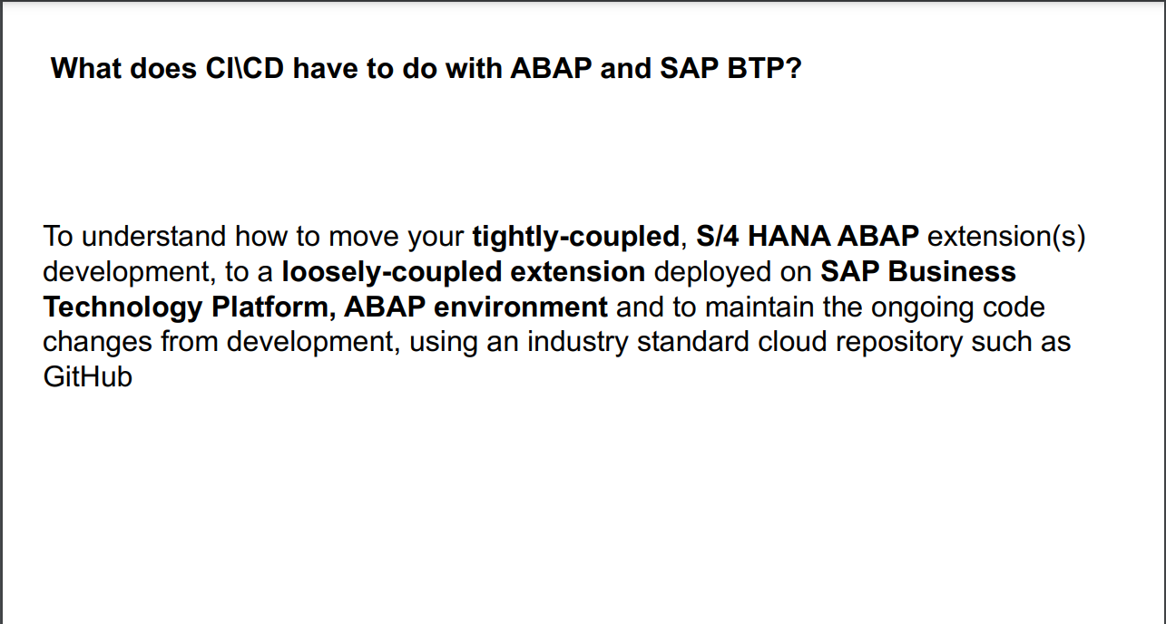

Slide 70
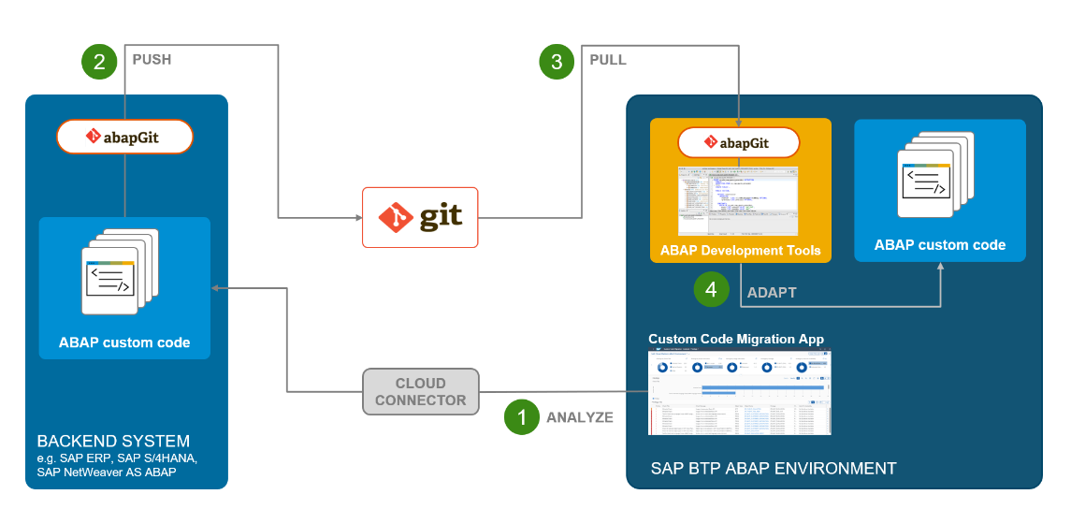
Flow to transfer ABAP source code via abapgit- (ABAP SAP Continuous Integration and Delivery)
The following picture demonstrates how the technical transfer of ABAP custom code from your on premise SAP system to SAP BTP ABAP Environment looks like.

Slide 71
Step 1- Analyse your ABAP custom code for Cloud readiness with SAP Fiori App Custom Code Migration. The App runs in the SAP BTP ABAP Environment, executes remotely (based on ABAP Test Cockpit) Cloud readiness checks on the ABAP custom code in your on premise SAP system, and provides the analytical presentation of the ATC check results with comprehensive filtering and navigation capabilities. During analysis focus on ABAP custom code scope for Cloud, get familiar with ABAP language version Cloud, released objects for Cloud and find out, which issues can be fixed in a semi-automated way using Quick Fixes in ABAP Development Tools in Eclipse. After the analysis is done, it’s time to transfer ABAP custom code to SAP BTP ABAP Environment. The technical infrastructure for this is the ABAPGIT.
Step 2- Use the ABAPGIT client in SAP GUI to export the ABAP custom code from on premise SAP system and store it in the Git Repository.
Step 3- Use the ABAPGIT plugin in ABAP Development Tools in Eclipse to import ABAP custom code from the Git Repository to SAP BTP ABAP Environment.
Step 4- Adapt the imported code in ABAP system in SAP BTP ABAP Environment The recommended way to do so is again using the Cloud readiness checks and ABAP Test Cockpit. That means check code with the ATC locally in your ABAP system in the SAP BTP ABAP Environment to get the custom code adaptation worklist. To automate the adaptation of the findings you can use the mass-enabled Quick Fixes for Cloud in ABAP Development Tools in Eclipse

Slide 72
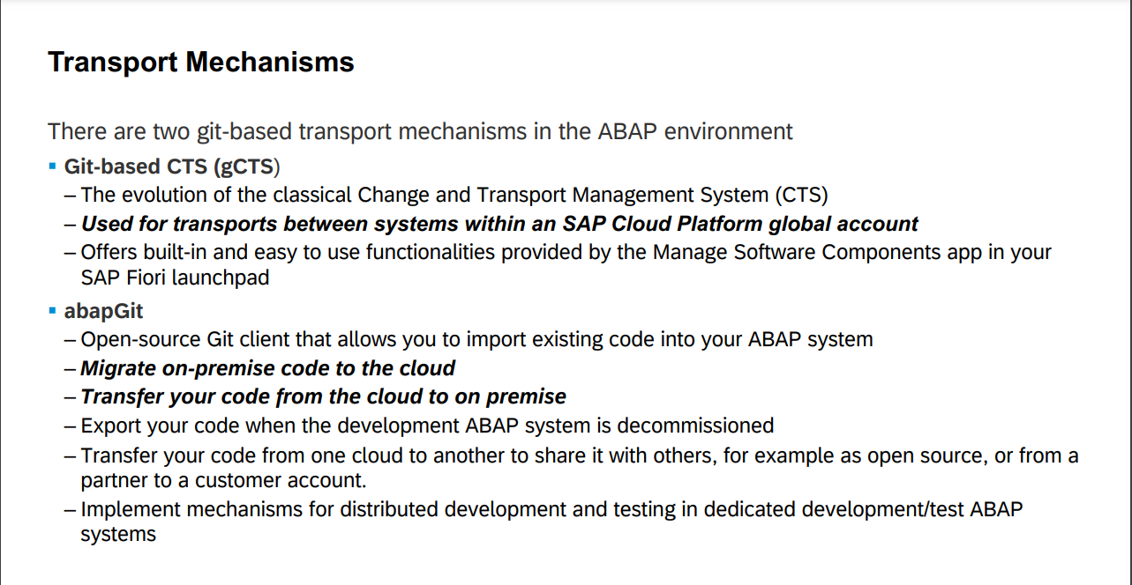

Slide 73
References
https://saplearninghub.plateau.com/learning/user/deeplink.do?OWASP_CSRFTOKEN=HQ05-ROYU-JAT6-9L8R-BYOV-7LQ0-4DKK-1B7I&linkId=ONLINE_CONTENT_STRUCTURE&componentID=PSD_WEB_22365_EN&componentTypeID=EXPERT_LED&fromSF=Y&revisionDate=1641544500000
https://blogs.sap.com/2018/10/02/how-to-check-your-custom-abap-code-for-sap-cloud-platform-abap-environment/
https://developers.sap.com/tutorials/abap-environment-abapgit.html

Slide 74

Thank You
GET THE FUTURE YOU WANT
capgemini.com

Slide 75
CONTENTs-
1
Introduction
SAP BTP ABAP LIFE CYCLE MANAGEMENT
Flow to transfer ABAP source code via
ABAPGIT
Transfer ABAP Source Code via abapGit
SAP ABAP Code Check

Slide 76

Transfer ABAP Source Code via abapGit (Use abapGit to Transfer Your On-Premise ABAP Source Code to the Cloud)
Steps:-
Create a Git repository
Install and set up ABAPGit
Push ABAP source from on premise to Git repository
Add ABAP development objects
Stage and commit developed objects
Install ABAPGit Eclipse plugin
Open ABAPGit repositories
Clone Git repository into SAP BTP ABAP Environment

Slide 77

Use ABAPGit to Transfer Your On-Premise ABAP Source Code to the Cloud

Slide 78
Push Your ABAP Source Code from SAP BTP, ABAP Environment to a GitHub Repository using ABAPGit
Create or adapt source code in ABAP instance
Open abapGit repositories
Stage and commit ABAP development objects

Slide 79
How to check your custom ABAP code for SAP BTP ABAP Environment

